Slide 1
Contrast Enhancement of Satellite Images Using Histogram Equalization
Nahom Abera

Slide 2
Agenda:
Slide 3: Abstract
Slide 4 - 6 : Introduction, Background, Problem Statement and Objectives
Slide 7: Literature Review
Slide 8: Dataset Description
Slide 9: Implementation and Methodology
Slide 10: Performance Metrics Calculation
Slide 11: Data Storage and Analysis
Slide 12 - 14: Results
Slide 15 - 17: Conclusion, Implications and Limitations
Slide 18: References

Slide 3
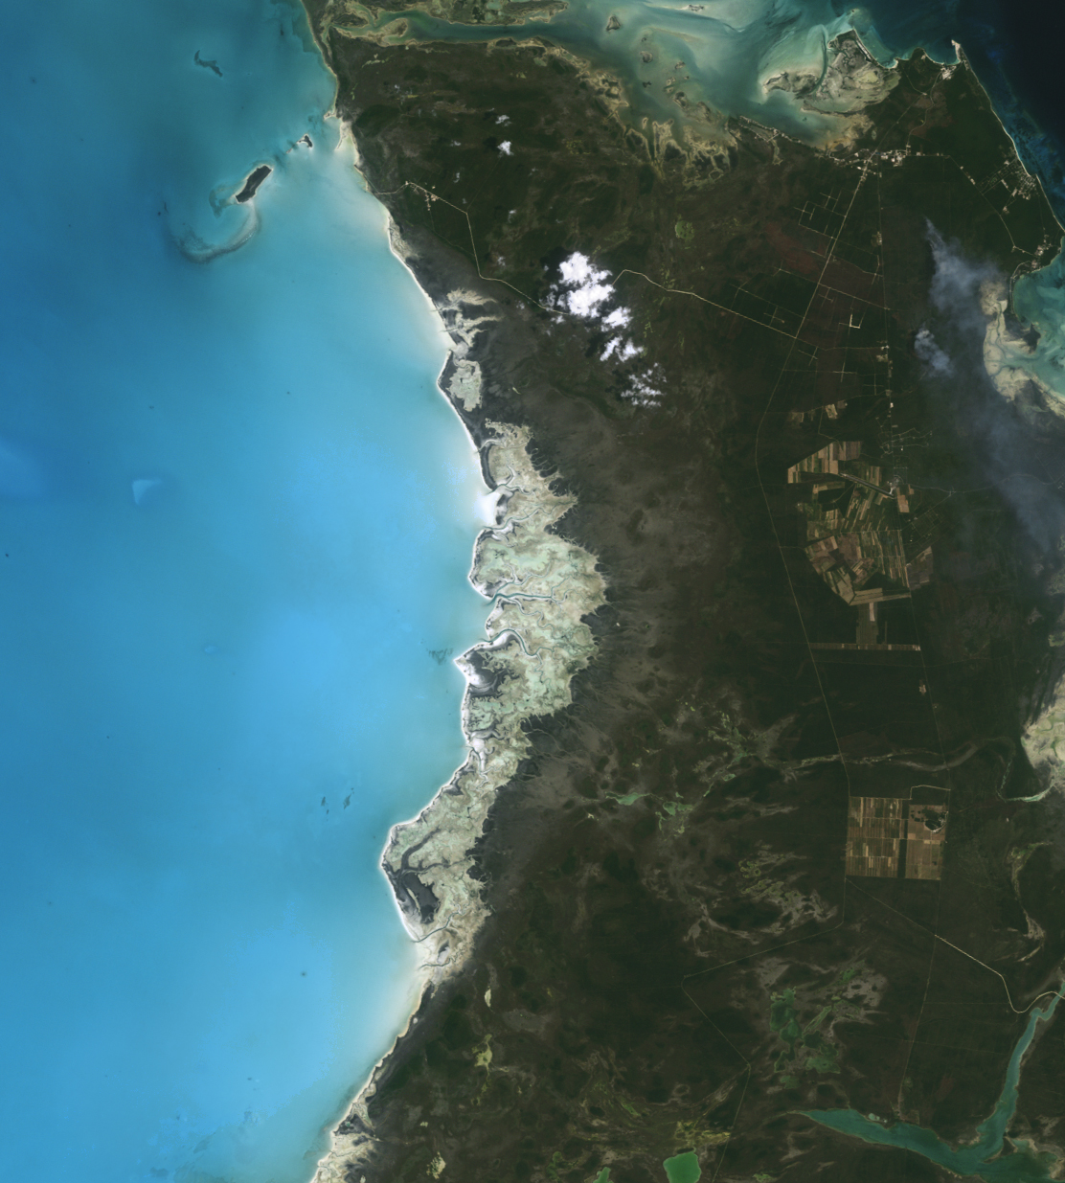
Abstract
Satellite imagery is crucial for applications like urban planning, environmental monitoring, and disaster management.
Enhancing contrast and visibility is essential for accurate analysis.
This study explores Global Histogram Equalization (HE) and Contrast-Limited Adaptive Histogram Equalization (CLAHE) on both grayscale and color satellite images.
Dataset: RSI-CB256 from Kaggle (5,631 images across four classes).
Metrics Used: Peak Signal-to-Noise Ratio (PSNR) and Structural Similarity Index (SSIM).
Notes:
Satellite imagery is essential for numerous applications, including urban planning, environmental monitoring, and disaster management.
Enhancing the contrast and visibility of these images is crucial for accurate analysis. This research explores the effectiveness of Global Histogram Equalization (HE) and Contrast-Limited Adaptive Histogram Equalization (CLAHE) in enhancing both grayscale and color satellite images.
Using the RSI-CB256 dataset from Kaggle, which contains 5,631 images across four classes (cloudy, desert, green_area, water), we apply HE and CLAHE to each image.
We calculate quantitative metrics, Peak Signal-to-Noise Ratio (PSNR) and Structural Similarity Index (SSIM), for each enhanced image and store the results in CSV files.
The average PSNR and SSIM values are computed to compare the overall performance of HE and CLAHE. Visual assessments are also conducted to qualitatively evaluate the enhancement.

Slide 4
Introduction
Importance of Satellite Imagery:
Critical for urban planning, environmental monitoring, disaster management.
Clarity and contrast are vital for accurate interpretation.
Challenges:
Low contrast due to atmospheric conditions and sensor limitations.
Solution:
Applying histogram equalization techniques to enhance image contrast.
Notes:
Satellite imagery plays a critical role in various applications ranging from urban planning to environmental monitoring and disaster management.
The clarity and contrast of these images are essential for accurate interpretation and analysis.
However, many satellite images suffer from low contrast due to atmospheric conditions, sensor limitations, and imaging parameters.
Enhancing the contrast of these images is crucial to making terrain features more visible and easily interpretable.

Slide 5
Background
Global Histogram Equalization (GHE):
Enhances contrast by redistributing image intensity values.
Global HE considers the entire image.
Contrast-Limited Adaptive Histogram Equalization (CLAHE):
Applies HE locally on small regions (tiles).
Prevents over-enhancement of noise.
Notes:
Histogram is a graphical representation of the intensity distribution of an image.
In simple terms, it represents the number of pixels for each intensity value considered.
Histogram Equalization (HE) is a technique that improves contrast by redistributing the intensity values of the entire image.
Contrast-Limited Adaptive Histogram Equalization (CLAHE) applies histogram equalization locally in small regions or tiles.
The main difference is Global Histogram Equalization considers the entire image, while Contrast-Limited Adaptive Histogram Equalization (CLAHE) applies to small regions or tiles.
CLAHE often yields better results by improving the contrast and visibility of images without over enhancing noise.

Slide 6
Problem Statement and Objectives
Problem Statement:
Low contrast in satellite images hinders terrain feature identification.
Main Objective:
Enhance satellite image contrast using Global HE and CLAHE.
Specific Goals:
Improve visibility of key features of the satellite image.
Compare effectiveness across different terrains and conditions.
Notes:
Satellite images often have low contrast, making it difficult to identify and analyze key terrain features.
This project focuses on evaluating the effectiveness of histogram equalization techniques, specifically HE and CLAHE, in enhancing the contrast of satellite images.
Objectives:
Main Objective: Enhance the contrast of satellite images using Global HE and CLAHE.
Specific Goals:
Improve the visibility of key terrain features such as roads, buildings, and vegetation.
Compare the effectiveness of Global HE and CLAHE across different types of terrains and atmospheric conditions.

Slide 7
Literature Review
Zuiderveld (1994):
Introduced CLAHE for medical imaging.
Improved local contrast without over-enhancing noise.
Landgrebe (2003):
Applied HE and CLAHE in remote sensing.
Enhanced image clarity for better classification accuracy.
Mather & Tso (2016):
Emphasized contrast enhancement in terrain classification.
CLAHE maintained feature clarity across varied terrains.
Notes:
Studies have been conducted to evaluate the effectiveness of histogram equalization techniques in image enhancement.
Zuiderveld (1994): Introduced Contrast-Limited Adaptive Histogram Equalization (CLAHE) primarily for medical imaging. The technique effectively improved local contrast and preserved details without over-enhancing noise. This method can be adapted to satellite imagery to enhance local features.
Landgrebe (2003): Discussed the application of histogram equalization and CLAHE in multispectral remote sensing images. These techniques significantly benefited agricultural and environmental monitoring by improving image clarity and contrast, leading to better classification accuracy.
Mather & Tso (2016): Highlighted the importance of contrast enhancement in remote sensing and terrain classification. They demonstrated that histogram equalization, particularly CLAHE, could maintain the clarity of features across varied terrain types, thus improving the overall usability of satellite images.
These studies establish a robust foundation for applying HE and CLAHE to enhance contrast of images. They show that while Global HE can improve overall contrast, CLAHE is often more effective in preserving local details and preventing over-enhancement.

Slide 8
Dataset Description
RSI-CB256 Dataset
Total Images: 5,631 JPEG images.
Classes:
Cloudy (1,500 images)
Desert (1,131 images)
Green Area (1,500 images)
Water (1,500 images)
Image Size: 256×256 pixels.
Why This Dataset?
Diverse terrains and environnemental conditions.
Ideal for comprehensive analysis.

Slide 9
Implementation and Methodology
Data Loading and Preprocessing:
Images read from class-specific folders.
Converted to grayscale and processed in color.
Enhancement Techniques:
Global HE:
Grayscale: Applied directly.
Color: Applied to Y channel in YCrCb color space.
CLAHE:
Grayscale: Applied with contrast limiting.
Color: Applied to Y channel to enhance local contrast.
Notes:
YCrCb:
Y (luminance) channel – Brightness
chrominance channels (Cr and Cb) – color:
Cb is the blue-difference chroma: represents the difference between the blue color component and the luminance (Y).
Cr is the red-difference chroma: is the difference between the gamma-corrected red value and the luma

Slide 10
Performance Metrics Calculation
Peak Signal-to-Noise Ratio (PSNR):
Measures image quality compared to the original.
Structural Similarity Index (SSIM):
Assesses luminance, contrast, and structure preservation.
Adjustments:
The window size parameter adjusted for small images.
The channel axis specified for color images.
Notes:
Peak Signal-to-Noise Ratio (PSNR):
Measures the ratio between the maximum possible power of a signal (image) and the power of corrupting noise, indicating the quality of the enhanced image compared to the original.
Structural Similarity Index (SSIM):
Assesses the visual impact of three characteristics of an image: luminance, contrast, and structure.
SSIM values are calculated between the original and enhanced images to evaluate the preservation of structural information. o
Adjustments for Image Size:
For small images, the win_size parameter in SSIM calculation is adjusted to prevent errors related to window size exceeding image dimensions.
For color images, the channel_axis parameter is specified to correctly handle multichannel data.

Slide 11
Data Storage and Analysis
Results Compilation:
PSNR and SSIM values for each image, method, and color space.
CSV Files:
Results saved for record-keeping and analysis.
Average Metrics Calculation:
Computed for each method and color space.
Notes:
Results Compilation: PSNR and SSIM values for each image, enhancement method (HE or CLAHE), and color space (grayscale or color) are compiled.
CSV Files: The compiled results are saved into CSV files for record-keeping and further analysis.
Average Metrics Calculation: The average PSNR and SSIM values are computed for each enhancement method(GHE and CLAHE) and color space(Gray and Color) across the entire dataset to facilitate a comparative analysis.

Slide 12
Quantitative Results
Average Metrics:
Interpretation:
Grayscale:
Both methods show low PSNR and SSIM values.
Minimal differences between HE and CLAHE.
Color:
Higher PSNR and SSIM indicate better quality preservation.
HE slightly outperforms CLAHE.
Method | Color Space | Average PSNR (dB) | Average SSIM
HE | Grayscale | 8.894570 | 0.227058
CLAHE | Grayscale | 8.977763 | 0.226548
HE | Color | 25.175466 | 0.839225
CLAHE | Color | 25.167423 | 0.834887
Notes:
PSNR:
In grayscale images, both HE and CLAHE yield low average PSNR values (~8.9 dB), indicating a lower signal-to-noise ratio.
CLAHE has a slightly higher PSNR than HE. o In color images, the average PSNR values are significantly higher (~25 dB), suggesting better preservation of image quality after enhancement. HE marginally outperforms CLAHE. •
SSIM:
The average SSIM values for grayscale images are low (~0.22), indicating less structural similarity between the original and enhanced images.
HE shows a slightly higher SSIM than CLAHE.
For color images, SSIM values are much higher (~0.83), indicating good structural similarity.
HE slightly surpasses CLAHE in SSIM.

Slide 13
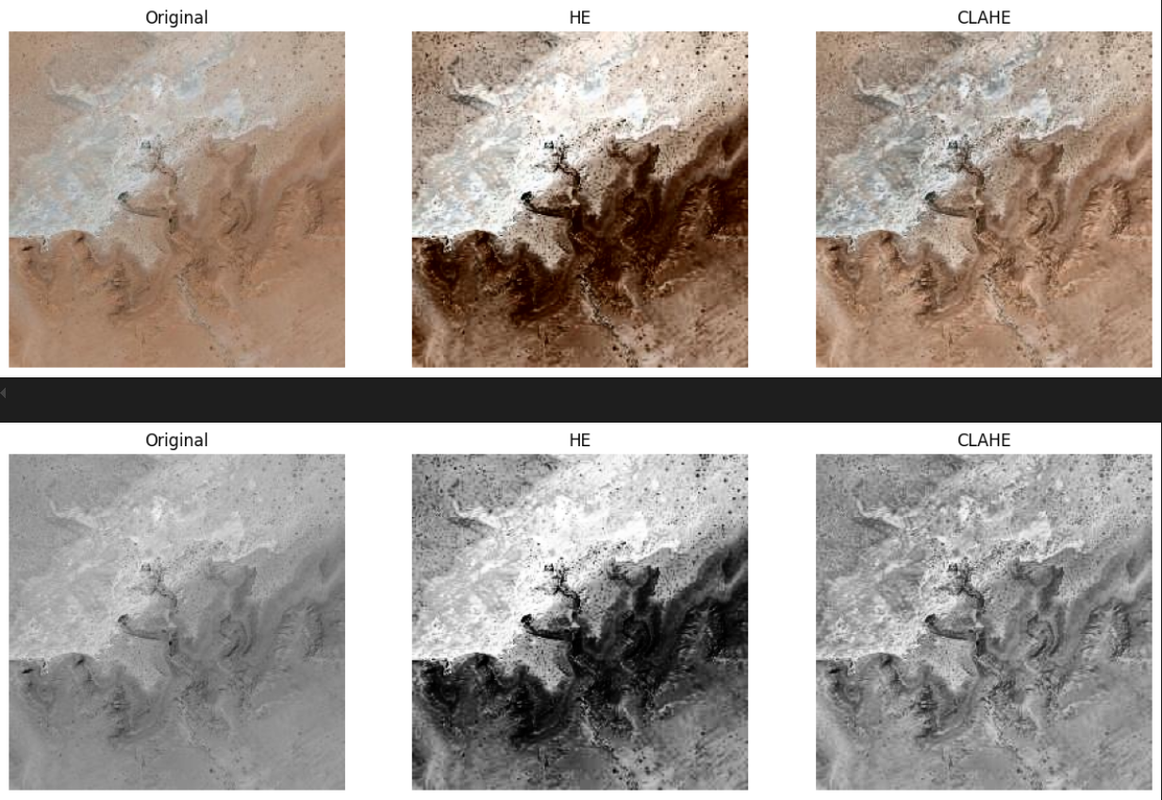
Qualitative Results
Top Row (Color Images):
Original: Natural terrain features with earthy tones.
HE: Darker image with enhanced contrast; shadows and highlights exaggerated.
CLAHE: Balanced contrast enhancement; details enhanced while maintaining natural tones.
Bottom Row (Grayscale Images):
Original: Relies on brightness and contrast variations.
HE: Increased contrast; bright and dark regions more distinct but may appear intense.
CLAHE: Smoother contrast enhancement; finer details highlighted without over-intensification.
Notes:
Color:
HE (Histogram Equalization):
The image appears darker with enhanced contrast compared to the original.
Shadows and bright areas are exaggerated, making fine details more prominent but at the expense of natural balance.
CLAHE (Contrast-Limited Adaptive Histogram Equalization):
The image retains a more balanced contrast compared to HE.
Details are enhanced while preserving the natural tones and textures.
CLAHE effectively improves local contrast without introducing significant artifacts or over-enhancement.
Gray:
HE (Histogram Equalization):
This version shows increased contrast, making bright and dark regions more distinct.
However, it appears more intense than the original, with potential loss of detail in overexposed or underexposed areas. •
CLAHE (Contrast-Limited Adaptive Histogram Equalization):
The image shows smoother contrast enhancement compared to HE, highlighting finer details without overly dramatic contrasts.
It maintains a more natural appearance and avoids excessive intensity.

Slide 14
Qualitative Results: Observations
HE vs. CLAHE:
Color Images:
HE enhances global contrast but may distort natural colors.
CLAHE improves local contrast without significant artifacts.
Grayscale Images:
HE may cause over-intensification.
CLAHE maintains a more natural appearance.
Preservation of Natural Appearance:
CLAHE better preserves natural tones and textures.
HE may introduce over-saturation and unnatural contrasts.

Slide 15
Conclusion
Color Images:
HE slightly outperforms CLAHE in PSNR and SSIM.
CLAHE preserves natural appearance and enhances local details.
Choice depends on whether global contrast or naturalness is prioritized.
Grayscale Images:
Both methods yield similar quantitative results.
CLAHE provides better qualitative enhancement without over-intensification.

Slide 16
Implications
Method Selection:
For Color Images:
Use CLAHE for preserving natural tones and enhancing local details.
HE suitable for global contrast enhancement.
For Grayscale Images:
CLAHE recommended for balanced enhancement.
Enhancement Effectiveness:
CLAHE's balanced enhancement is valuable for detailed analysis.

Slide 17
Limitations
Dataset Resolution:
Small image size (256×256 pixels) may limit generalizability.
Affects effectiveness of enhancement techniques.
Metric Sensitivity:
PSNR and SSIM may not fully capture perceptual quality.
Additional metrics or subjective evaluations needed.

Slide 18
References
Zuiderveld, K. (1994). Contrast Limited Adaptive Histogram Equalization. In P. S. Heckbert (Ed.), Graphics gems IV (pp. 474-485). Academic Press.
Landgrebe, D. (2003). Signal Theory Methods in Multispectral Remote Sensing. John Wiley & Sons.
Mather, P. M., & Tso, B. (2016). Classification Methods for Remotely Sensed Data (2nd ed.). CRC Press.

Slide 19
Thanks!

